Slide 1




Core Java
Wrapper Classes
LEVEL – PRACTITIONER

Slide 2
Objectives
After completing this chapter you will be able to learn
What are Wrapper Classes?
Need of Wrapper Classes?
What are the types of Wrapper Classes?
How to use Wrapper API to manipulate the wrapper classes?

Slide 3


Wrapper Classes
Wrapper Classes are an object representation of primitive data types.
Toffee
Toffee wrapped using a wrapper
Similarly, the primitive data types (the actual chocolate) are wrapped or converted into objects using wrapper classes
converted to
Primitive data types Wrapper Objects

Slide 4
Why to Wrap primitive Data?
Why do we use wrapper Classes?
Primitive data type are not objects. Whenever the data is required as a object, wrapper classes can be used to convert the primitive data into an object
Example: Collection can store only objects so primitives should be converted into Objects using wrapper and stored in collections.
Wrapper classes provide many utility methods for processing the primitive data types.
Example: Comparing two values, converting number to String etc.
Refer to the Java documentation for the various API’s available to process the primitive data using Wrapper classes. http://docs.oracle.com/javase/1.5.0/docs/api/

Slide 5
Primitive To Wrapper Mapping
Each primitive data type has a corresponding Wrapper class.
The name of the wrapper object is same as the primitive data type except that the first letter is capitalized.
Eight wrapper classes exist in java.lang package that represent 8 primitive data types
Example: Wrapper class of
boolean is Boolean
double is Double

Slide 6
Primitive To Wrapper Mapping
Primitive Data Type | Wrapper Class
boolean | Boolean
byte | Byte
short | Short
int | Integer
long | Long
float | Float
double | Double
char | Character
All the wrapper classes comes under the java.lang package.

Slide 7
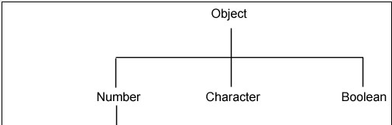
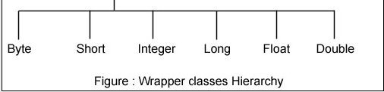
Wrapper Classes Hierarchy
Super class of Boolean and Character is Object
Super class of all Numeric wrapper classes is Number
Number has six concrete subclasses that hold explicit values of each numeric type Double, Float, Byte, Short, Integer, and Long.

Slide 8
Converting Primitives to Wrappers
How to convert primitive to wrappers?
Wrapper constructors are used to create class objects from primitive types.
Here the double primitive
Example: Double salary = new Double(“5.0d”);
value 5.0 is converted to double wrapper object.
Similarly each primitive can be converted to wrapper object using the respective constructor.
Boolean boolean1= new Boolean("false");
Byte byte1= new Byte("2");
Short short1= new Short("4");
Integer int1 = new Integer("16");
Long long1 = new Long("123");
Float
float1 = new Float("12.34f");
Double double1 = new Double("12.56d");
Character char1 = new Character('c');

Slide 9
Converting Wrappers to Primitives
How to convert wrappers to primitive ?
Each wrapper provides methods to return the primitive value of the Object representation.
Here the Salary Double
Example: double sal = salary.doubleValue();
wrapper object is converted to double primitive value.
Wrapper object can be converted to the respective primitive value as follows,
int i = int1.intValue();
boolean b = boolean1.booleanValue();
byte bt = byte1.byteValue();
short s = short1.shortValue();
long l = long1.longValue();
float f = float1.floatValue();
char c = char1.charValue();

Slide 10


Convert int to String
How to convert int to String & vice versa?
You will often have the need to convert String to int and vice versa. This is done using methods in the Integer class.
Example1:
int penn = Integer.parseInt(“45000”);
Similarly, String object can be converted to any primitive using the corresponding Wrapper Classes
o
The above statement converts the String “45000” int an int data type with value as 45000.
Example2:
String penn = Integer.toString(100);
The above statement converts the int 100 into an String data type with value as 100.

Slide 11


Wrapper Classes
Let us learn about each of the Wrapper classes in detail

Slide 12



Integer Wrapper Class
The Integer class wraps a value of the primitive type int into an object.
This class also provides several methods for converting int to String and vice versa, as well as other useful methods for processing int value.
Let us learn to use the various Integer APIs:
Example 1: To get the primitive int Value of the Integer object
Integer intObject = new Integer(5); int priIntValue = intObject.intValue();
The Integer object with value 5 is converted into a primitive int data type.
Example 2: To get the value of the Integer as a String.
Integer intObject = new Integer(5);
String stringValue = intObject.toString();
The Integer object with value 5 is converted into a String Object.

Slide 13

Are You Smart?
The Integer class has lot more APIs.
Are you smart enough to remember all API’s?
You do not have to remember every method in the Integer class. Instead you can refer to the APIs available on the Web.
Navigate to http://docs.oracle.com/javase/1.5.0/docs/api/java/lang/Integer.html and go through the various APIs available for the Integer class.

Slide 14

Lend a Hand – Integer Wrapper
Refer the Java documentation and choose the right API’s for doing the below exercise.
Create a java class “IntegerDemo” inside the package com.wrapper.demos.
Create a main method and create two Integer Objects“val1” and “val2” with values 21122 and 43222. Implement the following logic,
Problem # 1: Convert val1 as int and val2 as long values and print the values as below.
Expected Output: “The int value of the Integer= ”<int value> & “The long value of the Integer= ”<long value>
Problem # 2: Compares both the Integer variables val1 and val2 using an API and print the bigger value.
Expected Output: “ The<value> is bigger than <value>”
Problem # 3: Retrieves and prints the Maximum and minimum value that an int can have.
Expected Output: “Maximum Int value=”<Max Value> “Minimum Int value=”<Min Value>
Problem # 4: Converts a String value of String s = “1234” to an int value and add 100 to it.
Expected Output: The string should be converted into a int incremented to 100 and store in a int variable.

Slide 15
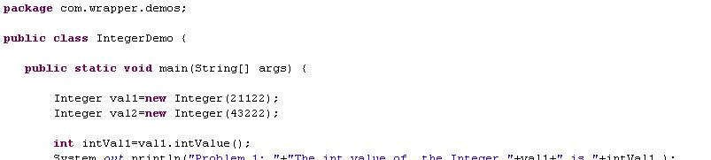
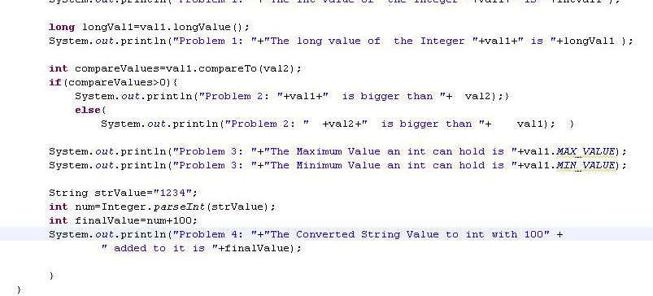
Lend a Hand - Solution
Develop the solution as mentioned below and check the output.

Slide 16
Long Wrapper Class
Class Long:
The Long class wraps a value of the primitive type long in an object.
This class also provides several methods for converting long to String and vice versa, as well as other constants and useful methods when processing a long value.
Long is similar to a Integer, the difference is size of Long is 64 bits rather int is 32 bits.
Syntax:
Long salary= new Long(“12678”) // Converting a String to a Long Wrapper
(or)
Long salary = new Long(12678);// Converting a long primitive to a Long Wrapper.

Slide 17

Float Wrapper Class
Class Float:
The Float class wraps a value of the primitive type float in an object.
This class also provides several methods for converting float to String and vice versa, as well as other useful methods when dealing with a float.
Example:

Slide 18
Lend a Hand – Float Wrapper
Refer the Java documentation and choose the right API’s for doing the below exercise.
Create a java class “FloatDemo”.
Create a main method and create two Float objects “val1” and “val2” with values 12.56f and 22.89f. Implement the following logic,
Problem 1: Compares two float variables and displays the maximum value.
Expected Output : “ The<value> is bigger than <value>”
Problem 2: Converts a String value of “1234” to a float value and add 10.2f
Expected Output: The string should be converted into a float incremented to 100 and store in a int variable.
Problem 3: Checks if the specified float value val1 is a number or not.
Expected Output: If the number is not a number display the message “This is not a Number” else “This is a Number”

Slide 19
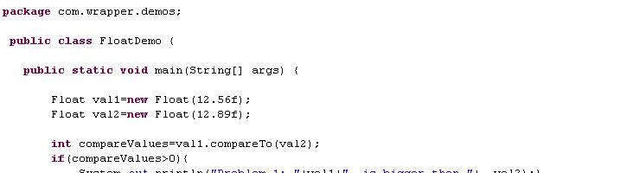
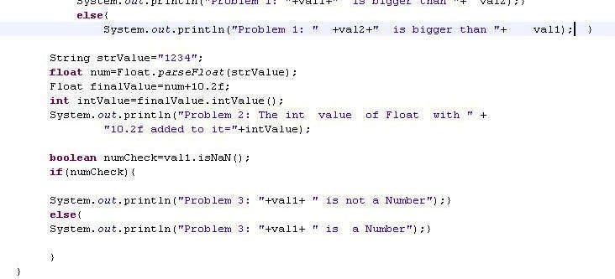
Lend a Hand - Solution
Develop the solution as mentioned and check the output.

Slide 20


Double Wrapper class
Class Double:
The Double class wraps a value of the primitive type double in an object. This class also provides several methods for converting double to String
and vice versa, as well as other useful method to process double value.
Double is similar to a float, the difference is size of double data type is 64 bits rather float is 32 bits.
Where is it used?
This is typically used for storing currency values.

Slide 21
Lend a Hand – Double
Refer the Java documentation and choose the right API’s for doing the below exercise.
Create a java class “DoubleDemo”.
Create a main method and create two Double objects “val1” and “val2” with values 87.89 and 212.82.The main method will have to print the following
Problem 1: Converts the val1 to int and val2 to float value.
Expected Output: “The int value of the Double Wrapper = ”<double value> & “The float value of the Double Wrapper= ”<long value>
Problem 2: Compares two double variables.
Expected Output: “ The<value> is bigger than <value>”
Problem 3: Converts a String value of “1234.89” to an double value and add 100.89 to it.
Expected Output:”The double value of the String with 100.89 added to it =“<double value>”.

Slide 22
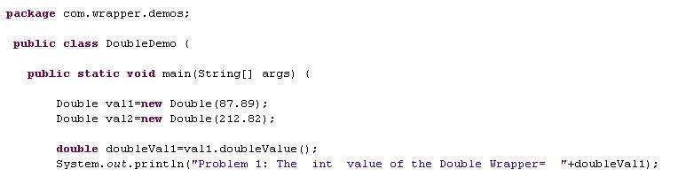
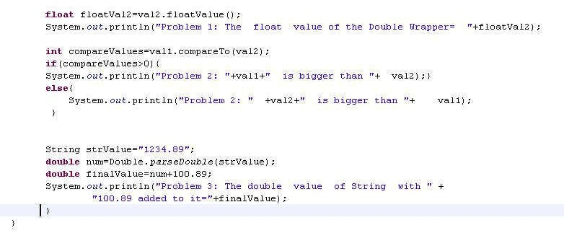
Lend a Hand - Solution
Develop the solution as mentioned and check the output.

Slide 23
Byte Wrapper Class
Class Byte:
The Byte class wraps a value of the primitive type byte in an object.
This class also provides several methods for converting byte to String and vice versa, as well as other constants and useful methods for processing a byte.
Where is it used?
This is typically used for storing numbers ranging between -128 and 127.
Syntax:
Byte id = new Byte(“12”) // Converting a String to a Byte Wrapper
(or)
Byte id = new Byte(12) // Converting a primitive to a Byte Wrapper

Slide 24
Short Wrapper Classes
Class Short:
The Short class wraps a value of the primitive type short in an object.
This class also provides several methods for converting short to String and vice versa, as well as other constants and useful methods. useful when dealing with a short.
Where is it used?
This is typically used for storing numbers ranging between – 32768 and 32767.
Syntax:
Short id = new Short(“1261”) // Converting a String to a Short Wrapper
(or)
Short salary = new Short (1267);// Converting a short primitive to a Short Wrapper.

Slide 25
Character Wrapper Class
Class Character:
The Character class wraps a value of the primitive type char in an object.
This class also provides several methods for determining a character’s category(lowercase letter, digit etc.) and for converting characters from uppercase to lowercase and vice versa.
Example: Characters ‘a’, ‘b’, ‘5’, ‘?’, ‘A’ can be represented a Character Object
Syntax:
Character flag = new Character(‘A’) // Converting a Primitive char type to Wrapper Character object type.

Slide 26
Boolean Wrapper class
Class Boolean:
The Boolean class wraps a value of the primitive type boolean in an object. This class also provides several methods for converting boolean to String
and vice versa, as well as other constants and useful methods when processing boolean data.
Syntax:
Boolean flag = new Boolean(“true”) // Converting a String to a Boolean Wrapper
(or)
Boolean flag = new Boolean(true);// Converting a boolean primitive to a Boolean Wrapper.

Slide 27
Lend a Hand – Boolean
Refer the Java documentation and choose the right API’s for doing the below exercise.
Create a java class “BooleanDemo”.
Create a main method, inside the main method, declare two Boolean wrapper objects, val1 and val2 with values true and false respectively.
The main method should implement the following logic,
Problem # 1: The hashcode for val1 and val2 needs to be printed.
Expected Output: “The hash code of val1 = ”<value> & “The hash code of val2= ”<value>

Slide 28

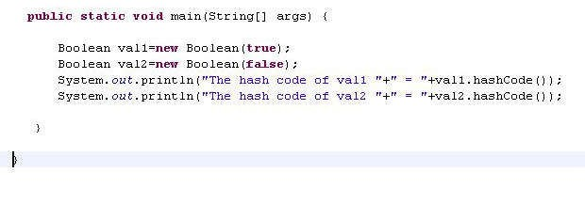
Lend a Hand - Solution
Develop the solution as mentioned and check the output.

Slide 29

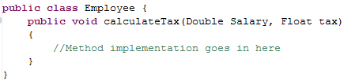
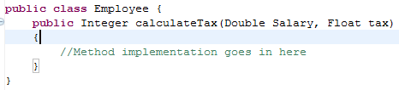
Where Wrappers can be used?
Wrappers can be used in the following scenarios,
As instance variables in class.
Example:
As method arguments.
Example:
Method with Double and Float arguments.
As method return type.
Method returns Integer type.
Example:

Slide 30

Time To Reflect
Associates to reflect the following topics.
Why do we need Wrapper Objects?
What Wrapper Object is used to store currency data?
How many Wrapper Objects are there?
What is the package under which the Wrapper objects are present?

Slide 31
You have successfully completed –
Wrapper Classes

